Slide 1
Memory Management
Chapter 3
Tanenbaum & Bo,Modern Operating Systems:4th ed., (c) 2013 Prentice-Hall, Inc. All rights reserved.

Slide 2
Memory
Paraphrase of Parkinson’s Law, ‘‘Programs expand to fill the memory available to hold them.’’
Average home computer nowadays has 10,000 times more memory than the IBM 7094, the largest computer in the world in the early 1960s
Tanenbaum & Bo,Modern Operating Systems:4th ed., (c) 2013 Prentice-Hall, Inc. All rights reserved.

Slide 3
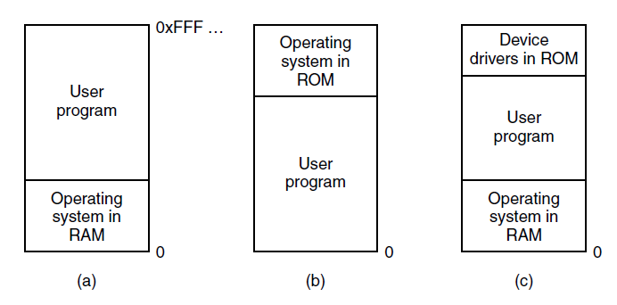
No Memory Abstraction
Figure 3-1. Three simple ways of organizing memory with an operating system and one user process. Other possibilities also exist
Tanenbaum & Bo,Modern Operating Systems:4th ed., (c) 2013 Prentice-Hall, Inc. All rights reserved.

Slide 4
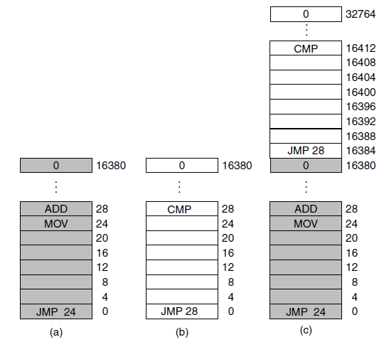
Running Multiple Programs Without a Memory Abstraction
Figure 3-2. Illustration of the relocation problem. (a) A 16-KB program. (b) Another 16-KB program. (c) The two programs loaded consecutively into memory.
Tanenbaum & Bo,Modern Operating Systems:4th ed., (c) 2013 Prentice-Hall, Inc. All rights reserved.

Slide 5
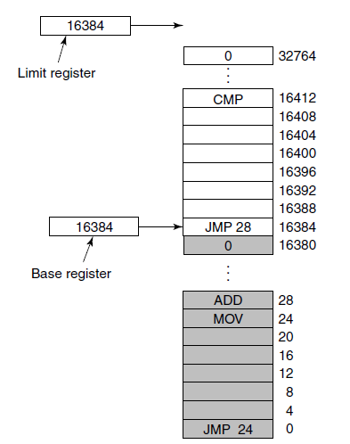
Base and Limit Registers
Figure 3-3. Base and limit registers can be used to give each process a separate address space.
Tanenbaum & Bo,Modern Operating Systems:4th ed., (c) 2013 Prentice-Hall, Inc. All rights reserved.

Slide 6
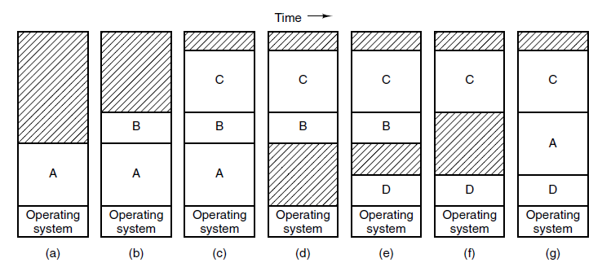
Swapping (1)
Figure 3-4. Memory allocation changes as processes come into memory and leave it. The shaded regions are unused memory
Tanenbaum & Bo,Modern Operating Systems:4th ed., (c) 2013 Prentice-Hall, Inc. All rights reserved.

Slide 7
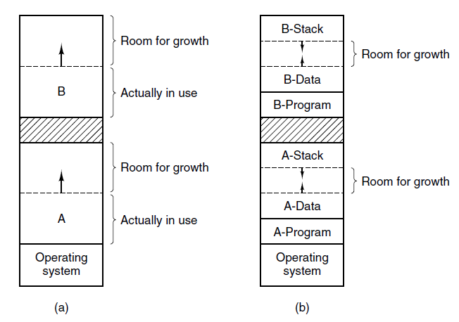
Swapping (2)
Figure 3-5. (a) Allocating space for a growing data segment.
(b) Allocating space for a growing stack and a growing data segment.
Tanenbaum & Bo,Modern Operating Systems:4th ed., (c) 2013 Prentice-Hall, Inc. All rights reserved.

Slide 8
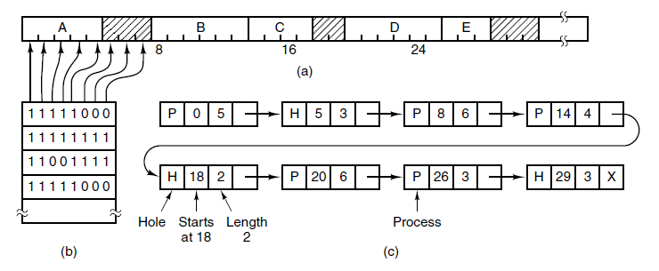
Memory Management with Bitmaps
Figure 3-6. (a) A part of memory with five processes and three holes. The tickmarks show the memory allocation units. The shaded regions (0 in the bitmap) are free. (b) The corresponding bitmap. (c) The same information as a list.
Tanenbaum & Bo,Modern Operating Systems:4th ed., (c) 2013 Prentice-Hall, Inc. All rights reserved.

Slide 9
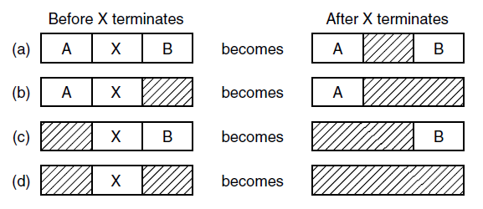
Memory Management with Linked Lists
Figure 3-7. Four neighbor combinations for the
terminating process, X.
Tanenbaum & Bo,Modern Operating Systems:4th ed., (c) 2013 Prentice-Hall, Inc. All rights reserved.

Slide 10
Memory Management Algorithms
First fit
Next fit
Best fit
Worst fit
Quick fit
Tanenbaum & Bo,Modern Operating Systems:4th ed., (c) 2013 Prentice-Hall, Inc. All rights reserved.

Slide 11
Virtual Memory
There is a need to run programs that are too large to fit in memory
Solution adopted in the 1960s, split programs into little pieces, called overlays
  Kept on the disk, swapped in and out of memory
Virtual memory : each program has its own address space, broken up into chunks called pages
Tanenbaum & Bo,Modern Operating Systems:4th ed., (c) 2013 Prentice-Hall, Inc. All rights reserved.

Slide 12
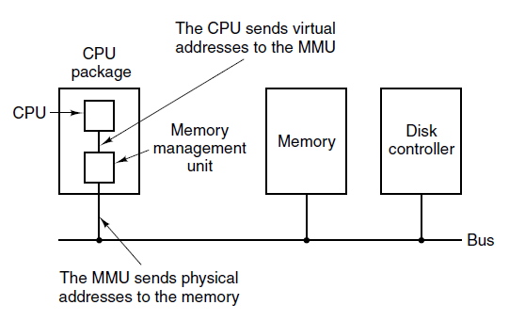
Paging (1)
Figure 3-8. The position and function of the MMU. Here the
MMU is shown as being a part of the CPU chip because
it commonly is nowadays. However, logically it
could be a separate chip and was years ago.
Tanenbaum & Bo,Modern Operating Systems:4th ed., (c) 2013 Prentice-Hall, Inc. All rights reserved.

Slide 13
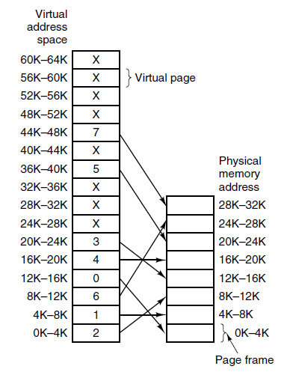
Paging (2)
Figure 3-9. The relation between virtual addresses and physical memory addresses is given by the page table. Every page begins on a multiple of 4096 and ends 4095 addresses higher, so 4K–8K really means 4096–8191 and 8K to 12K means 8192–12287
Tanenbaum & Bo,Modern Operating Systems:4th ed., (c) 2013 Prentice-Hall, Inc. All rights reserved.

Slide 14
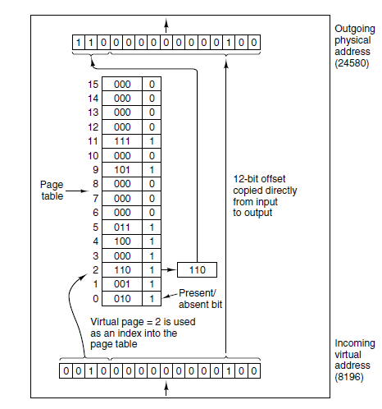
Paging (3)
Figure 3-10. The internal
operation of the MMU
with 16 4-KB pages.
Tanenbaum & Bo,Modern Operating Systems:4th ed., (c) 2013 Prentice-Hall, Inc. All rights reserved.

Slide 15
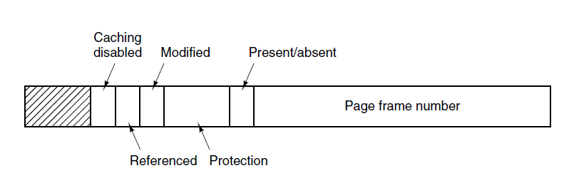
Structure of a Page Table Entry
Figure 3-11. A typical page table entry.
Tanenbaum & Bo,Modern Operating Systems:4th ed., (c) 2013 Prentice-Hall, Inc. All rights reserved.

Slide 16
Speeding Up Paging
Major issues faced:
The mapping from virtual address to physical address must be fast.
If the virtual address space is large, the page table will be large.
Tanenbaum & Bo,Modern Operating Systems:4th ed., (c) 2013 Prentice-Hall, Inc. All rights reserved.

Slide 17
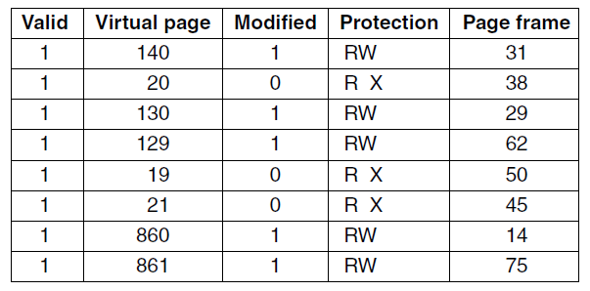
Translation Lookaside Buffers
Figure 3-12. A TLB to speed up paging.
Tanenbaum & Bo,Modern Operating Systems:4th ed., (c) 2013 Prentice-Hall, Inc. All rights reserved.

Slide 18
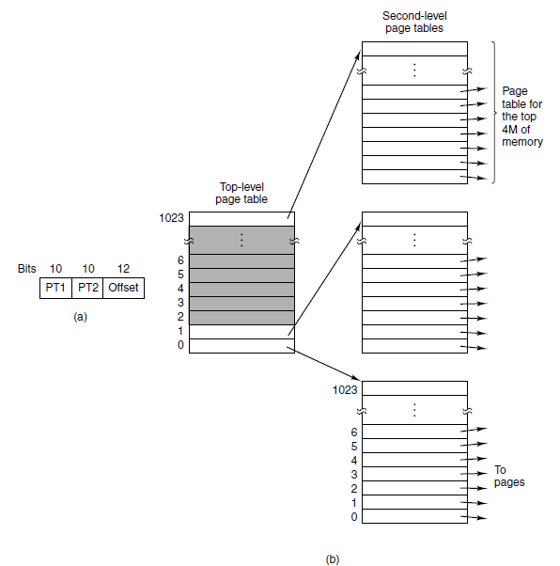
Multilevel Page Tables
Figure 3-13. (a) A 32-bit address with two page table fields. (b) Two-level page tables.
Tanenbaum & Bo,Modern Operating Systems:4th ed., (c) 2013 Prentice-Hall, Inc. All rights reserved.

Slide 19
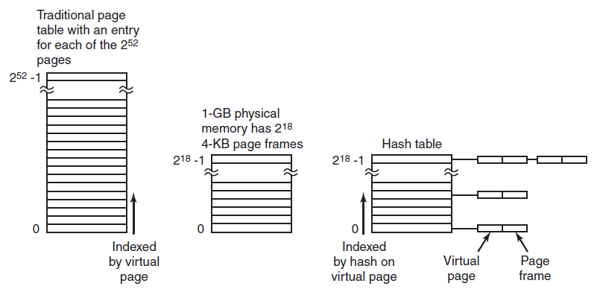
Inverted Page Tables
Figure 3-14. Comparison of a traditional page table
with an inverted page table.
Tanenbaum & Bo,Modern Operating Systems:4th ed., (c) 2013 Prentice-Hall, Inc. All rights reserved.

Slide 20
Page Replacement Algorithms
Optimal algorithm
Not recently used algorithm
First-in, first-out (FIFO) algorithm
Second-chance algorithm
Clock algorithm
Least recently used (LRU) algorithm
Working set algorithm
WSClock algorithm
Tanenbaum & Bo,Modern Operating Systems:4th ed., (c) 2013 Prentice-Hall, Inc. All rights reserved.

Slide 21
Not Recently Used Algorithm
At page fault, system inspects pages
Categories of pages based on the current values of their R and M bits:
Class 0: not referenced, not modified.
Class 1: not referenced, modified.
Class 2: referenced, not modified.
Class 3: referenced, modified.
Tanenbaum & Bo,Modern Operating Systems:4th ed., (c) 2013 Prentice-Hall, Inc. All rights reserved.

Slide 22
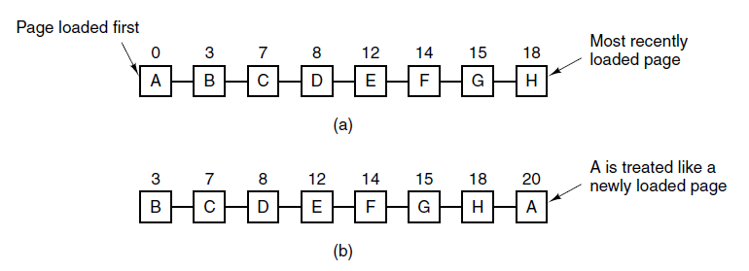
Second-Chance Algorithm
Figure 3-15. Operation of second chance. (a) Pages sorted in FIFO order. (b) Page list if a page fault occurs at time 20 and A has its R bit set. The numbers above the pages are their load times.
Tanenbaum & Bo,Modern Operating Systems:4th ed., (c) 2013 Prentice-Hall, Inc. All rights reserved.

Slide 23
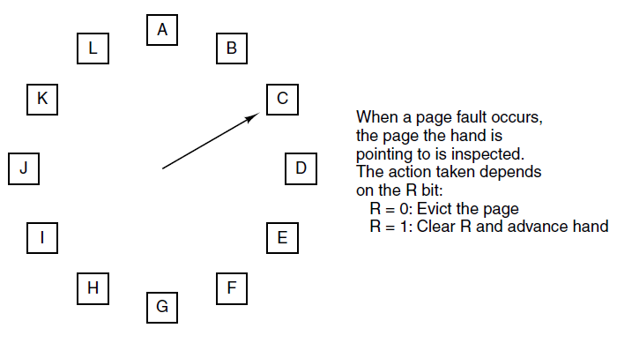
Clock Page Replacement Algorithm
Figure 3-16. The clock page replacement algorithm.
Tanenbaum & Bo,Modern Operating Systems:4th ed., (c) 2013 Prentice-Hall, Inc. All rights reserved.

Slide 24
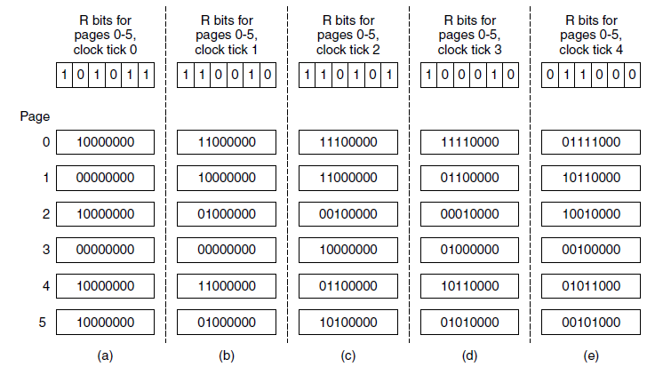
Simulating LRU in Software
Figure 3-17. The aging algorithm simulates LRU in software. Shown are six pages for five clock ticks. The five clock ticks are represented by (a) to (e).
Tanenbaum & Bo,Modern Operating Systems:4th ed., (c) 2013 Prentice-Hall, Inc. All rights reserved.

Slide 25
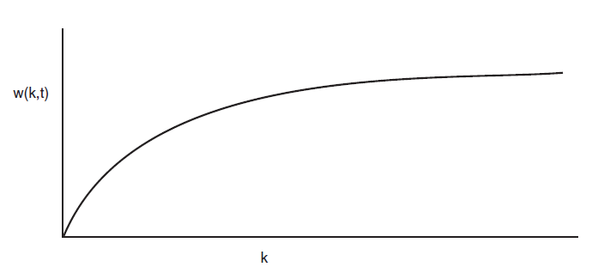
Working Set Algorithm (1)
Figure 3-18. The working set is the set of pages used by the k most recent memory references. The function w(k, t) is the size of the working set at time t.
Tanenbaum & Bo,Modern Operating Systems:4th ed., (c) 2013 Prentice-Hall, Inc. All rights reserved.

Slide 26
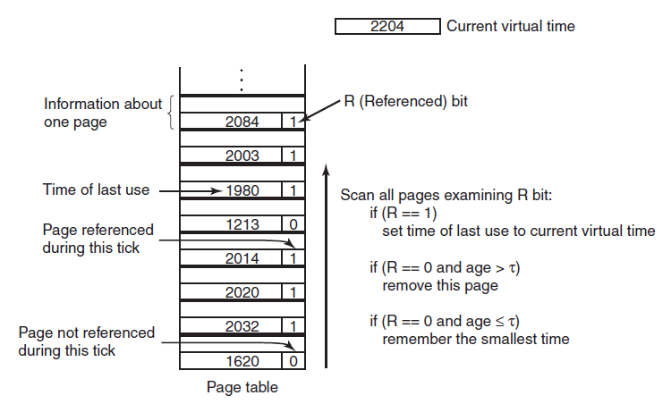
Working Set Algorithm (2)
Figure 3-19. The working set algorithm.
Tanenbaum & Bo,Modern Operating Systems:4th ed., (c) 2013 Prentice-Hall, Inc. All rights reserved.

Slide 27
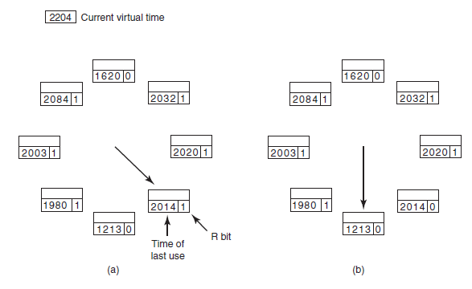
WSClock Algorithm (1)
Figure 3-20. Operation of the WSClock algorithm. (a) and (b) give an example of what happens when R = 1.
Tanenbaum & Bo,Modern Operating Systems:4th ed., (c) 2013 Prentice-Hall, Inc. All rights reserved.

Slide 28
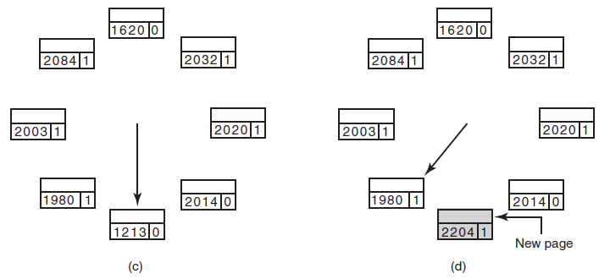
WSClock Algorithm (2)
Figure 3-20. Operation of the WSClock algorithm.
(c) and (d) give an example of R = 0.
Tanenbaum & Bo,Modern Operating Systems:4th ed., (c) 2013 Prentice-Hall, Inc. All rights reserved.

Slide 29
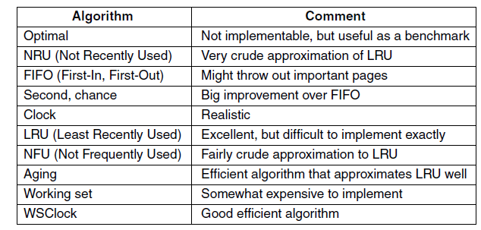
Summary of Page Replacement Algorithms
Figure 3-21. Page replacement algorithms discussed in the text.
Tanenbaum & Bo,Modern Operating Systems:4th ed., (c) 2013 Prentice-Hall, Inc. All rights reserved.

Slide 30
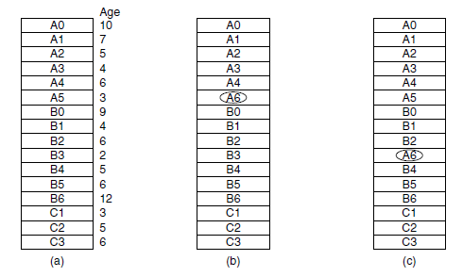
Local versus Global Allocation Policies (1)
Figure 3-22. Local versus global page replacement.
(a) Original configuration. (b) Local page replacement.
(c) Global page replacement.
Tanenbaum & Bo,Modern Operating Systems:4th ed., (c) 2013 Prentice-Hall, Inc. All rights reserved.

Slide 31
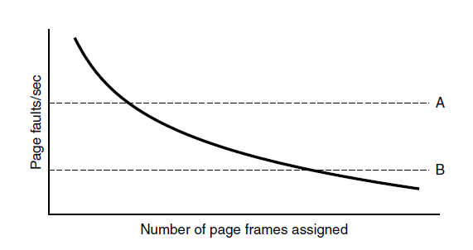
Local versus Global Allocation Policies (2)
Figure 3-23. Page fault rate as a function of the number of page frames assigned.
Tanenbaum & Bo,Modern Operating Systems:4th ed., (c) 2013 Prentice-Hall, Inc. All rights reserved.

Slide 32
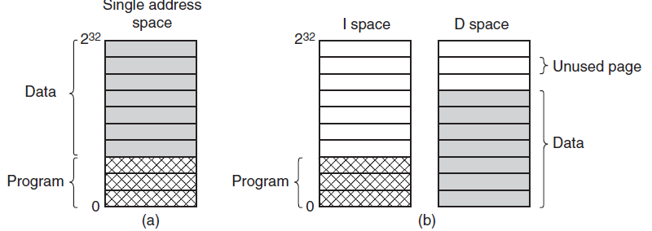
Separate Instruction and Data Spaces
Figure 3-24. (a) One address space.
(b) Separate I and D spaces.
Tanenbaum & Bo,Modern Operating Systems:4th ed., (c) 2013 Prentice-Hall, Inc. All rights reserved.

Slide 33
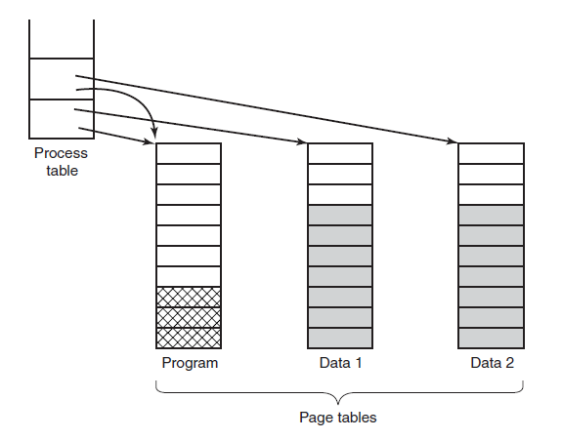
Shared Pages
Figure 3-25. Two processes sharing the same
program sharing its page table.
Tanenbaum & Bo,Modern Operating Systems:4th ed., (c) 2013 Prentice-Hall, Inc. All rights reserved.

Slide 34
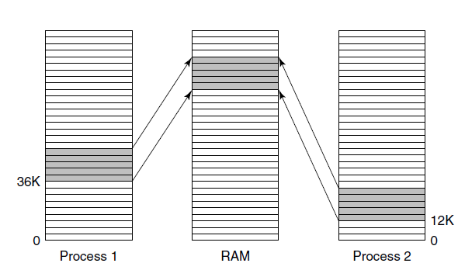
Shared Libraries
Figure 3-26. A shared library being used by two processes.
Tanenbaum & Bo,Modern Operating Systems:4th ed., (c) 2013 Prentice-Hall, Inc. All rights reserved.

Slide 35
Page Fault Handling (1)
The hardware traps to kernel, saving program counter on stack.
Assembly code routine started to save general registers and other volatile info
system discovers page fault has occurred, tries to discover which virtual page needed
Once virtual address caused fault is known, system checks to see if address valid and the protection consistent with access
Tanenbaum & Bo,Modern Operating Systems:4th ed., (c) 2013 Prentice-Hall, Inc. All rights reserved.

Slide 36
Page Fault Handling (2)
If frame selected dirty, page is scheduled for transfer to disk, context switch takes place, suspending faulting process
As soon as frame clean, operating system looks up disk address where needed page is, schedules disk operation to bring it in.
When disk interrupt indicates page has arrived, tables updated to reflect position, and frame marked as being in normal state.
Tanenbaum & Bo,Modern Operating Systems:4th ed., (c) 2013 Prentice-Hall, Inc. All rights reserved.

Slide 37
Page Fault Handling (3)
Faulting instruction backed up to state it had when it began and program counter is reset
Faulting process is scheduled, operating system returns to routine that called it.
Routine reloads registers and other state information, returns to user space to continue execution
Tanenbaum & Bo,Modern Operating Systems:4th ed., (c) 2013 Prentice-Hall, Inc. All rights reserved.

Slide 38
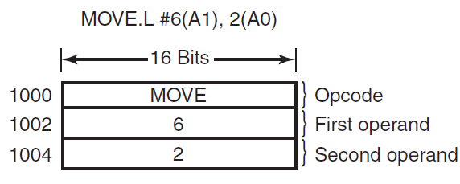
Instruction Backup
Figure 3-27. An instruction causing a page fault.
Tanenbaum & Bo,Modern Operating Systems:4th ed., (c) 2013 Prentice-Hall, Inc. All rights reserved.

Slide 39
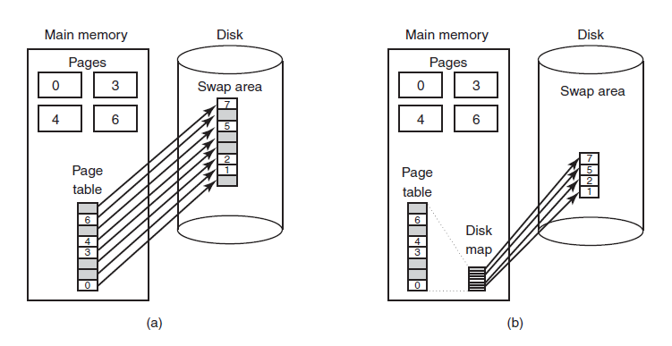
Backing Store
Figure 3-28. (a) Paging to a static swap area.
(b) Backing up pages dynamically.
Tanenbaum & Bo,Modern Operating Systems:4th ed., (c) 2013 Prentice-Hall, Inc. All rights reserved.

Slide 40
Separation of Policy and Mechanism (1)
Memory management system is divided into three parts
A low-level MMU handler.
A page fault handler that is part of the kernel.
An external pager running in user space.
Tanenbaum & Bo,Modern Operating Systems:4th ed., (c) 2013 Prentice-Hall, Inc. All rights reserved.

Slide 41
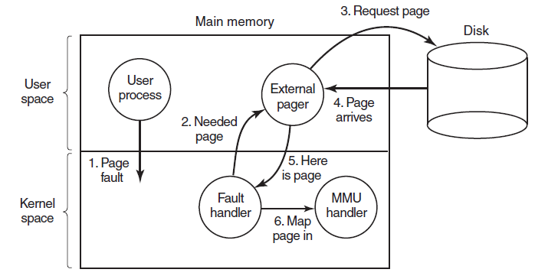
Separation of Policy and Mechanism (2)
Figure 3-29. Page fault handling with an external pager.
Tanenbaum & Bo,Modern Operating Systems:4th ed., (c) 2013 Prentice-Hall, Inc. All rights reserved.

Slide 42
Segmentation (1)
Examples of tables generated by compiler:
The source text being saved for the printed listing
The symbol table, names and attributes of variables.
The table containing integer and floating-point constants used.
The parse tree, syntactic analysis of the program.
The stack used for procedure calls within compiler.
Tanenbaum & Bo,Modern Operating Systems:4th ed., (c) 2013 Prentice-Hall, Inc. All rights reserved.

Slide 43
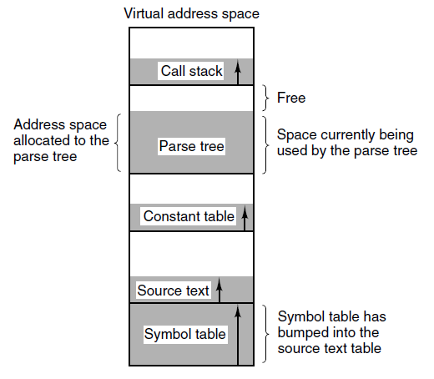
Segmentation (2)
Figure 3-30. In a one-dimensional address space with growing tables, one table may bump into another.
Tanenbaum & Bo,Modern Operating Systems:4th ed., (c) 2013 Prentice-Hall, Inc. All rights reserved.

Slide 44
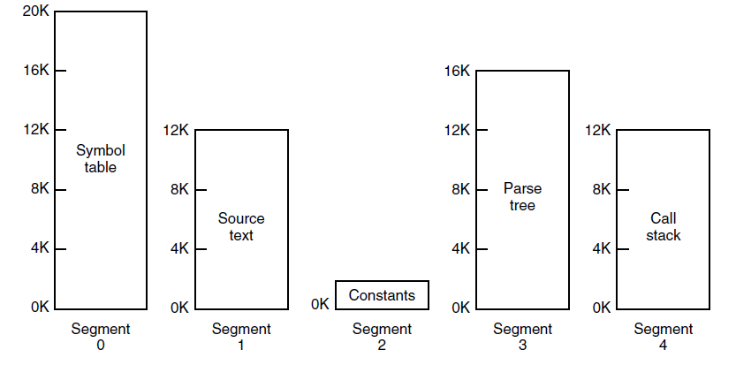
Segmentation (3)
Figure 3-31. A segmented memory allows each table to grow or shrink independently of the other tables.
Tanenbaum & Bo,Modern Operating Systems:4th ed., (c) 2013 Prentice-Hall, Inc. All rights reserved.

Slide 45
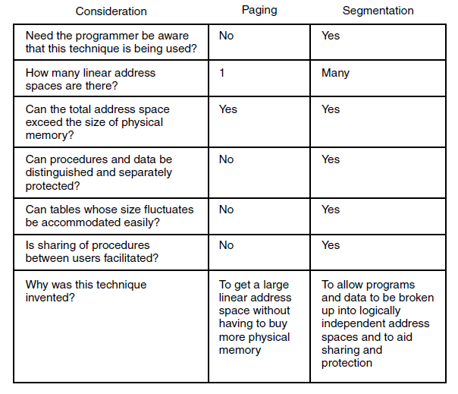
Segmentation (4)
Figure 3-32. Comparison of paging and segmentation
Tanenbaum & Bo,Modern Operating Systems:4th ed., (c) 2013 Prentice-Hall, Inc. All rights reserved.

Slide 46
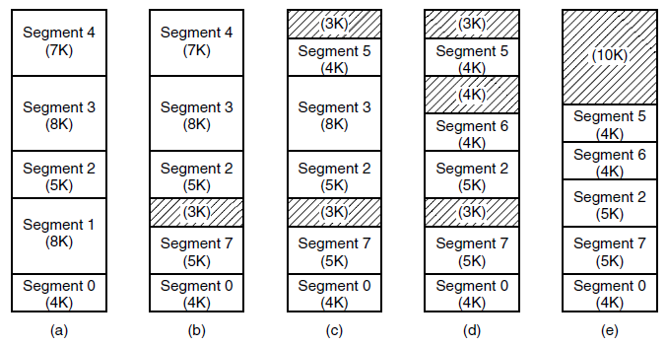
Implementation of Pure Segmentation
Figure 3-33. (a)-(d) Development of checkerboarding.
(e) Removal of the checkerboarding by compaction.
Tanenbaum & Bo,Modern Operating Systems:4th ed., (c) 2013 Prentice-Hall, Inc. All rights reserved.

Slide 47
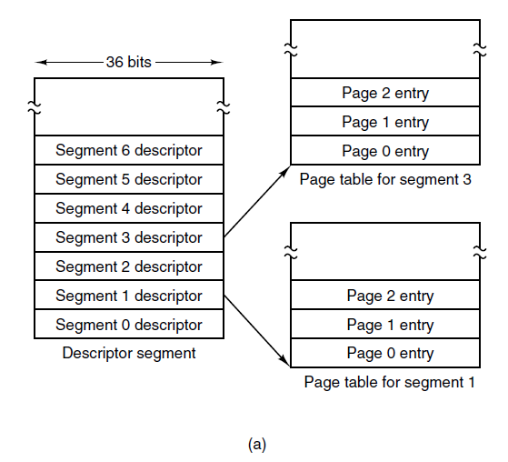
Segmentation with Paging: MULTICS (1)
Figure 3-34. The MULTICS virtual memory. (a) The descriptor segment pointed to the page tables.
Tanenbaum & Bo,Modern Operating Systems:4th ed., (c) 2013 Prentice-Hall, Inc. All rights reserved.

Slide 48
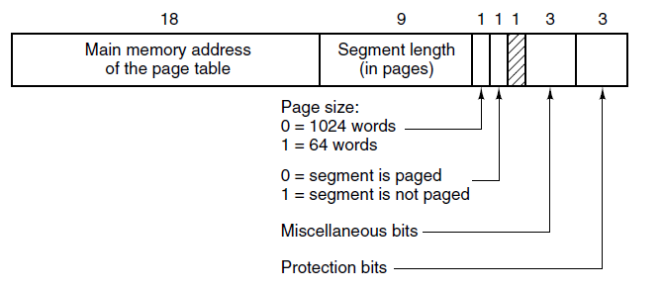
Segmentation with Paging: MULTICS (2)
Figure 3-34. The MULTICS virtual memory. (b) A segment descriptor. The numbers are the field lengths.
Tanenbaum & Bo,Modern Operating Systems:4th ed., (c) 2013 Prentice-Hall, Inc. All rights reserved.

Slide 49
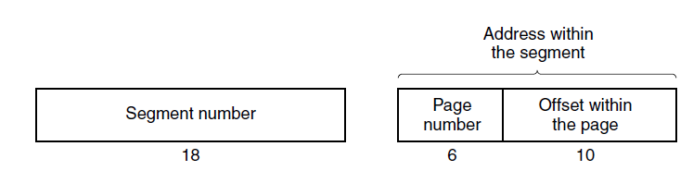
Segmentation with Paging: MULTICS (3)
Figure 3-35. A 34-bit MULTICS virtual address.
Tanenbaum & Bo,Modern Operating Systems:4th ed., (c) 2013 Prentice-Hall, Inc. All rights reserved.

Slide 50
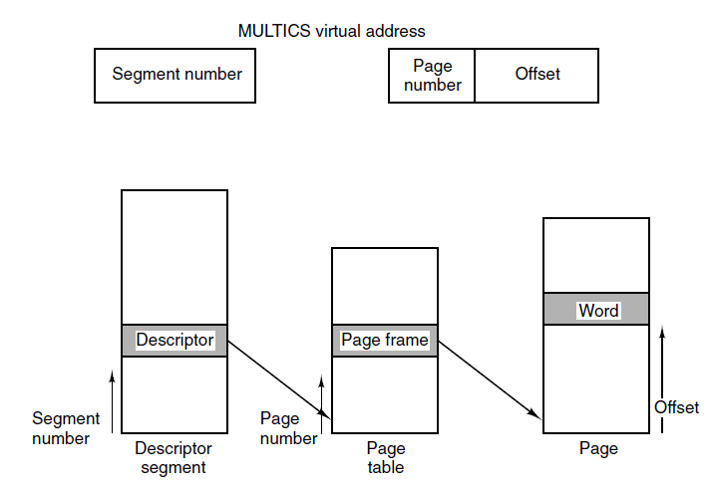
Segmentation with Paging: MULTICS (4)
Figure 3-36. Conversion of a two-part MULTICS address into a main memory address.
Tanenbaum & Bo,Modern Operating Systems:4th ed., (c) 2013 Prentice-Hall, Inc. All rights reserved.

Slide 51
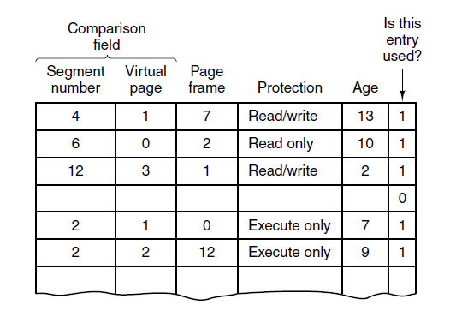
Segmentation with Paging: MULTICS (5)
Figure 3-37. A simplified version of the MULTICS TLB. The existence of two page sizes made the actual TLB more complicated.
Tanenbaum & Bo,Modern Operating Systems:4th ed., (c) 2013 Prentice-Hall, Inc. All rights reserved.

Slide 52
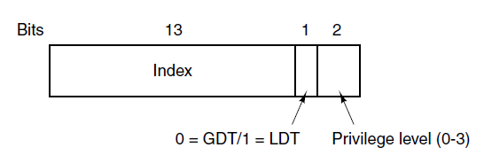
Segmentation with Paging:
The Intel x86 (1)
Figure 3-38. An x86 selector.
Tanenbaum & Bo,Modern Operating Systems:4th ed., (c) 2013 Prentice-Hall, Inc. All rights reserved.

Slide 53
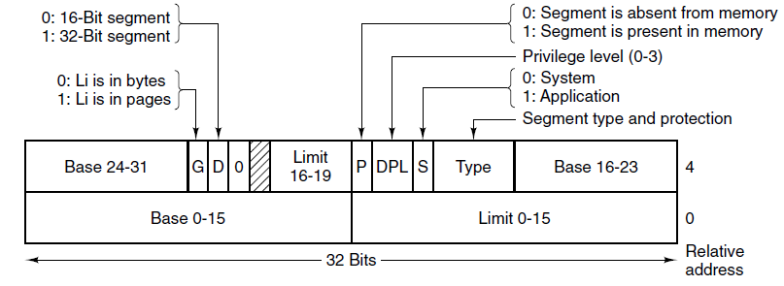
Segmentation with Paging:
The Intel x86 (2)
Figure 3-39. x86 code segment descriptor.
Data segments differ slightly.
Tanenbaum & Bo,Modern Operating Systems:4th ed., (c) 2013 Prentice-Hall, Inc. All rights reserved.

Slide 54
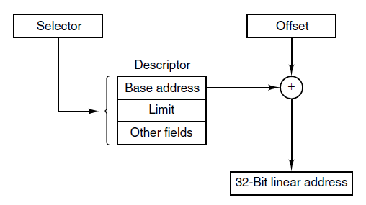
Segmentation with Paging:
The Intel x86 (3)
Figure 3-40. Conversion of a (selector, offset)
pair to a linear address.
Tanenbaum & Bo,Modern Operating Systems:4th ed., (c) 2013 Prentice-Hall, Inc. All rights reserved.

Slide 55
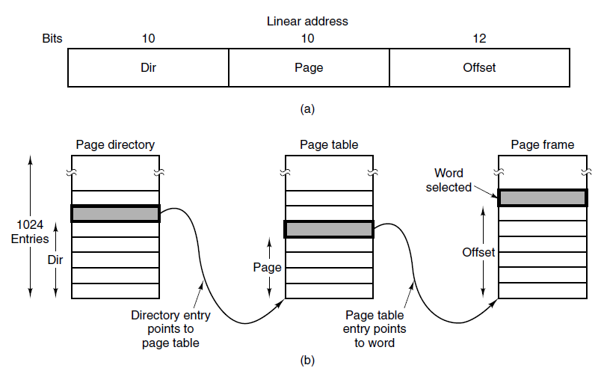
Segmentation with Paging:
The Intel x86 (4)
Figure 3-41. Mapping of a linear address
onto a physical address.
Tanenbaum & Bo,Modern Operating Systems:4th ed., (c) 2013 Prentice-Hall, Inc. All rights reserved.

Slide 56
End
Chapter 3
Tanenbaum & Bo,Modern Operating Systems:4th ed., (c) 2013 Prentice-Hall, Inc. All rights reserved.

